Slide 1



IE412 AI for Finance: Mini Project 3
Factor analysis with clustering
TA: Youngbin Lee
young@unist.ac.kr
UNIST Financial Engineering Lab.

Slide 2
Contents
Stock clustering
Fama-French 3 Factors
Regression

Slide 3
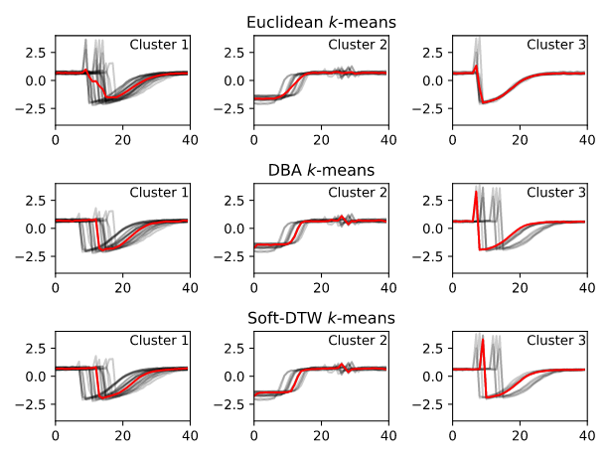
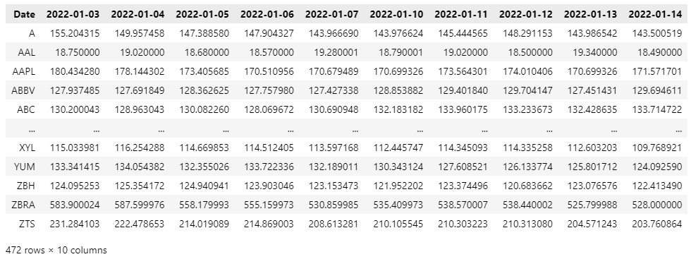
1. Stock clustering
1
Overview: Time-series clustering
Stock price data
Time-series clustering^{[1]}
^{[2]}
Sample
^{[3]}
Feature
The constantly changing stock price data is a time series data that has values at every time point.
Such time series data can be clustered with stocks as samples and prices at each time points as features.
The most common method is k-means clustering, where distance measures such as Euclidean distance and DTW are possible.
[1] https://tslearn.readthedocs.io/en/stable/auto_examples/clustering/plot_kmeans.html#sphx-glr-auto-examples-clustering-plot-kmeans-py
[2] F. Petitjean, A. Ketterlin & P. Gancarski. A global averaging method for dynamic time warping, with applications to clustering. Pattern Recognition, Elsevier, 2011, Vol. 44, Num. 3, pp. 678-693
[3] M. Cuturi, M. Blondel “Soft-DTW: a Differentiable Loss Function for Time-Series,” ICML 2017.

Slide 4
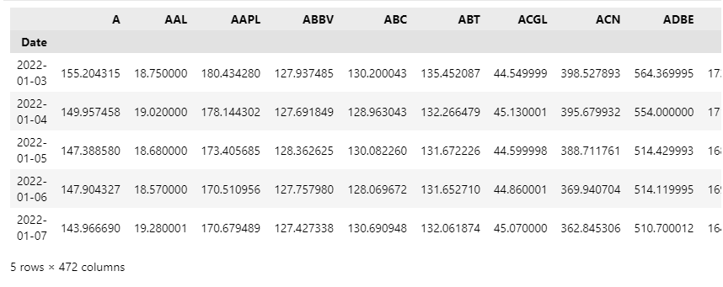
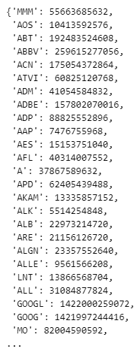
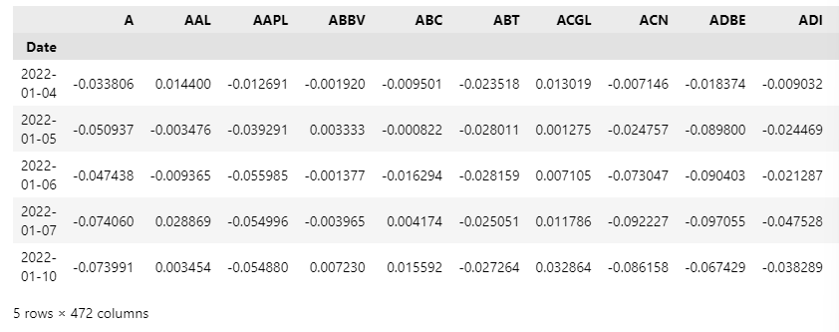
1. Stock clustering
2
Load data
S&P500 daily price
S&P500 market cap
S&P500 cumulative return
* Date: Jan 1, 2022 ~ Dec 31, 2022
* Date: May 18, 2023
To perform clustering, we retrieve daily closing price data from Yahoo Finance^{[1]} and convert it into cumulative returns.
Additionally, we obtain market capitalization information to examine the clustering results based on it.
[1] https://github.com/ranaroussi/yfinance

Slide 5
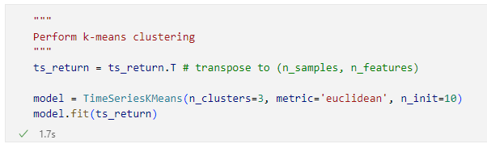
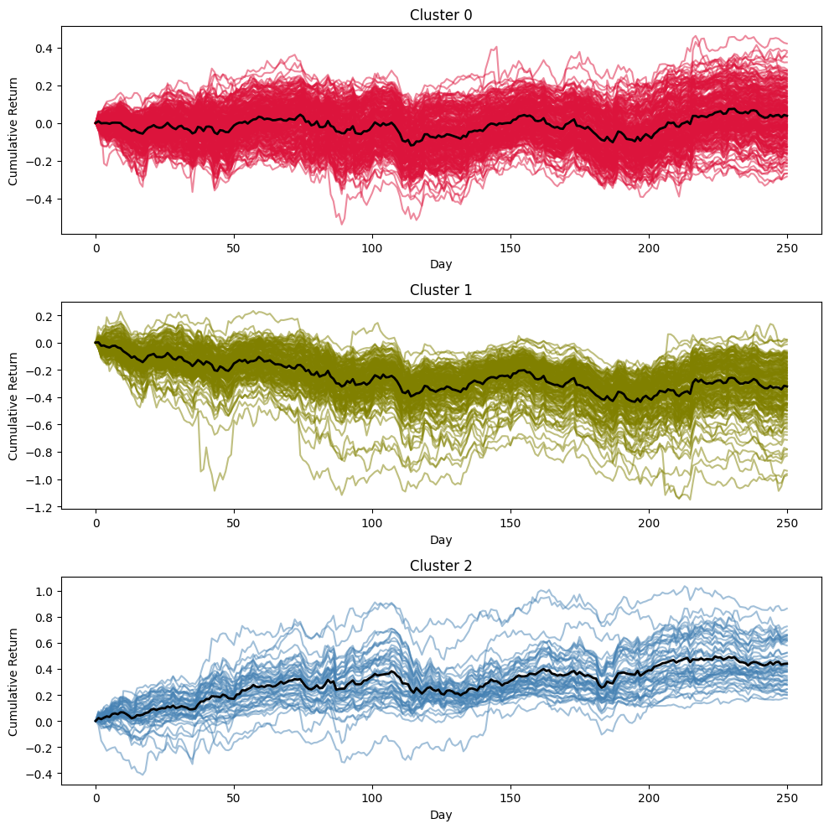
1. Stock clustering
3
Perform clustering
Model and hyperparameters
Result
A clustering model can be implemented using the machine learning package "tslearn^{[1]}" for time series data.
The following hyperparameters are used:
n_cluster=3
To compare it with the Fama-French 3 Factor model, stocks were grouped into 3 clusters.
metric=‘Euclidean’
The distance between stocks was calculated using the Euclidean distance.
n_init=10
Since clustering is sensitive to initialization, the final result will be the best output of n_init consecutive runs.
A visualization of the stock time series corresponding to each cluster and the cluster centers
[1] https://tslearn.readthedocs.io/en/stable/auto_examples/clustering/plot_kmeans.html#sphx-glr-auto-examples-clustering-plot-kmeans-py

Slide 6
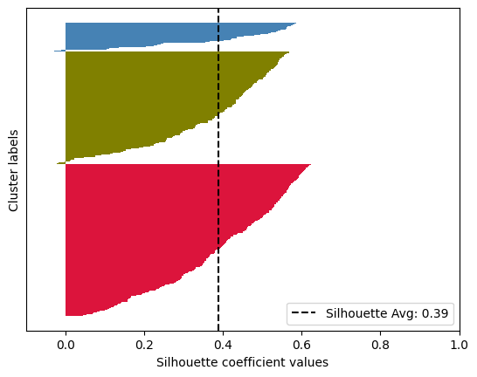
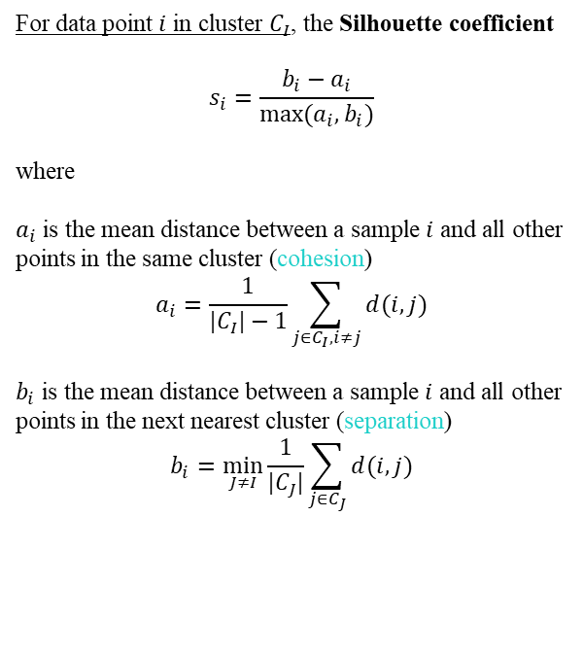
1. Stock clustering
4
Performance evaluation
Silhouette coefficient
Result
A measure of cohesion compared to separation
Range: [-1, 1]
Higher scores indicate dense and well separated clusters
For data point $i$ in cluster $C_{I}$, the Silhouette coefficient
$$s_{i}=\frac{b_{i}−a_{i}}{max⁡(a_{i},b_{i})}$$
where
$a_{i}$ is the mean distance between a sample $i$ and all other points in the same cluster (cohesion)
$$a_{i}=\frac{1}{|C_{I}|−1}\sum_{j∈C_{I}, i≠j}{d(i,j)}$$
$b_{i}$ is the mean distance between a sample $i$ and all other points in the next nearest cluster (separation)
$$b_{i}=\min_{J≠I}{\frac{1}{|C_{J}|}\sum_{j∈C_{J}}{d(i,j)}}$$
We calculated the Silhouette scores using the Euclidean distance measure for our clustering results and visualized them.
When calculating Silhouette scores, various pairwise distances such as cosine, L1, and L2 can be used as the distance measure^{[1]}.
[1] https://scikit-learn.org/stable/modules/generated/sklearn.metrics.pairwise_distances.html

Slide 7
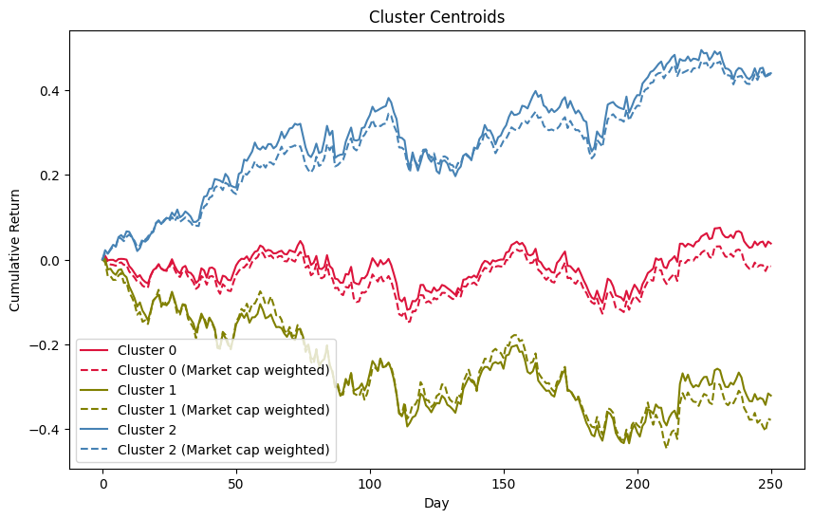
1. Stock clustering
5
Cluster centers as factors
The cluster centers were visualized based on the three clusters obtained from clustering.
In the figure, the solid line represents the simple average of the cumulative return values within the cluster, while the dotted line represents the weighted average based on market capitalization.
Clustering can be used to find factors, but it is also possible to use other machine learning techniques such as PCA or AutoEncoder to identify factors.

Slide 8
2. Fama-French 3 Factors
1
Overview: Fama-French 3 Factors
Market excess return
Outperformance of small versus big companies
Outperformance of high value versus low value companies

Slide 9
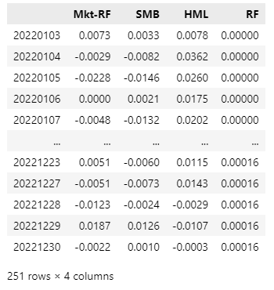
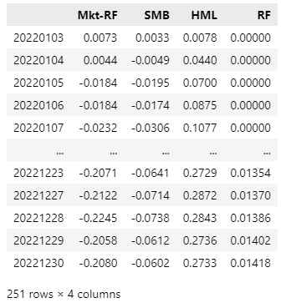
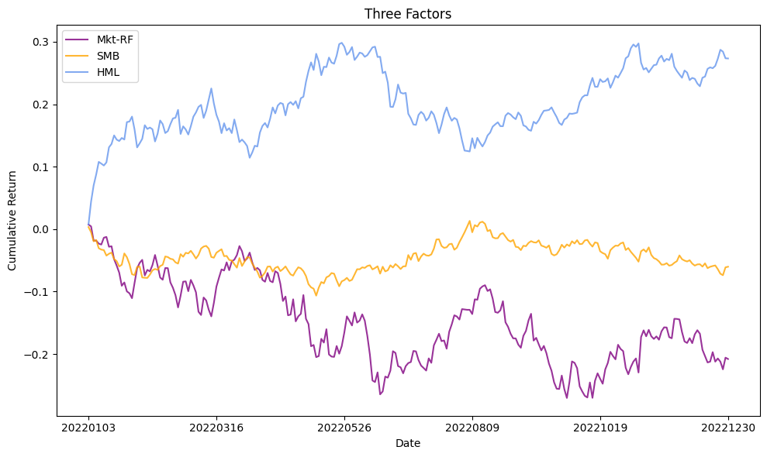
2. Fama-French 3 Factors
2
Load data
F-F daily return
Visualization
F-F cumulative return
* Date: Jan 1, 2022 ~ Dec 31, 2022
To compare with the factors obtained from clustering, we obtain daily data for 3 factors^{[1]} and convert them into cumulative returns.
The return paths of the three factors are visualized.
[1] https://mba.tuck.dartmouth.edu/pages/faculty/ken.french/data_library.html

Slide 10
2. Fama-French 3 Factors
3
Comparison with cluster factors
VS
Comparing with the three cluster centers obtained earlier:
Cluster 0 resembles the SMB factor, which oscillates around zero during the given period.
Cluster 1 exhibits a movement similar to the Mkt-RF factor.
Cluster 2 resembles the HML factor, which shows a consistent upward trend during the given period.

Slide 11
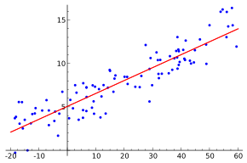
3. Regression analysis
1
Overview: Linear regression
Example of simple linear regression, which has one independent variable^{[1]}.
[1] https://en.wikipedia.org/wiki/Linear_regression

Slide 12
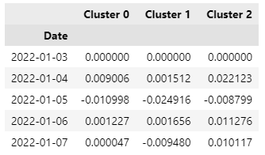
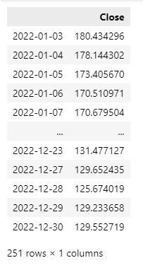
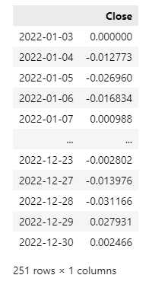
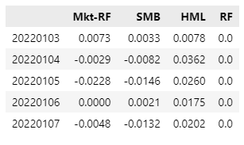
3. Regression analysis
2
Load data
Cluster factors
AAPL daily price
AAPL log return
F-F 3 factors
To fit the daily price movements of individual stocks to the factors, we retrieve Apple stock data and convert it into log returns.

Slide 13
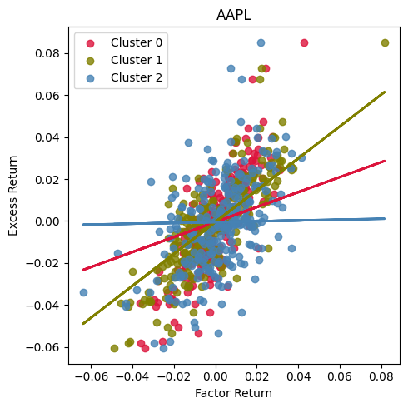
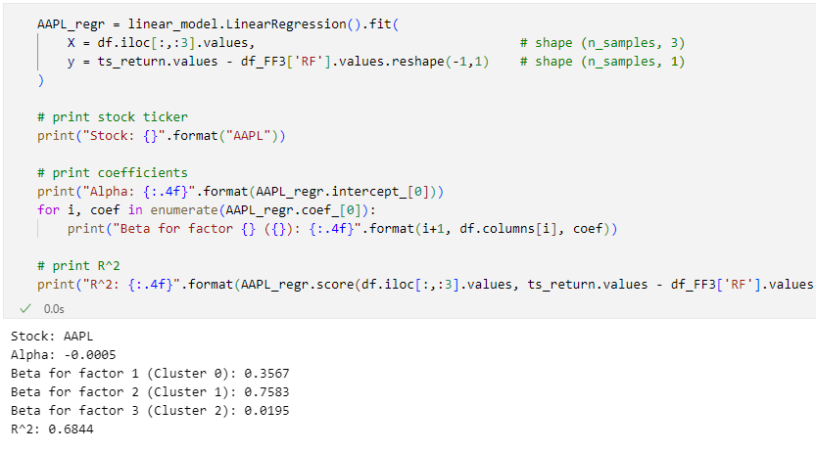
3. Regression analysis
3
Perform linear regression
Fitting the cluster factors
The Apple stock, with the largest market capitalization, has a strong correlation with the Cluster 1 which is similar to the market factor.

Slide 14
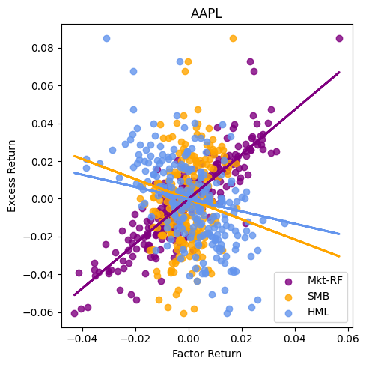
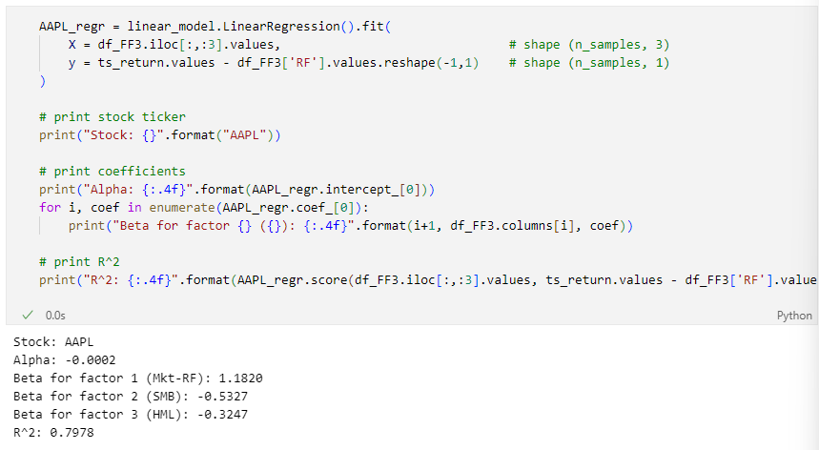
3. Regression analysis
4
Perform linear regression
Fitting the F-F 3 factors
The Apple stock, with the largest market capitalization, has a significant negative correlation with the size factor.

Slide 15

Questions
&
Answers
_
E-mail: young@unist.ac.kr
15

Slide 16
Thank You.

